Slide 1




Big Data
Airbnb Analysis
Amr Ahmed Abdelzaher 1190074
Karim Yasser Ali 1190175 Mostafa Osama Abdelzaher 1190173 Omar Mohamed Ahmed Amin 1190204

Slide 2


CONTENT
01
02
03
04
About the Dataset
Business Insights
Technical Insights
Results and Conclusion

Slide 3


Dataset
The dataset at our disposal encompasses a wide range of attributes related to Airbnb accommodations. It includes information such as property type, room type, amenities, pricing, host characteristics, geographical location, and guest reviews, among others.
With over 70K entries spanning diverse locations, this dataset offers a holistic view of the global Airbnb landscape.

Slide 4





Business Insights
Where
Market
Price and Regulation
Success
The Analysis performed will help property owners know where to buy properties
The Analysis will help owners understand the market better by understanding the Airbnb ecosystem and know what to buy and what not to buy
The Analysis will help business owners decide what prices to give for their properties
following the learnings of the analysis the business owners will be sure of success of their properties by buying the correct properties and amenities in the correct place

Slide 5
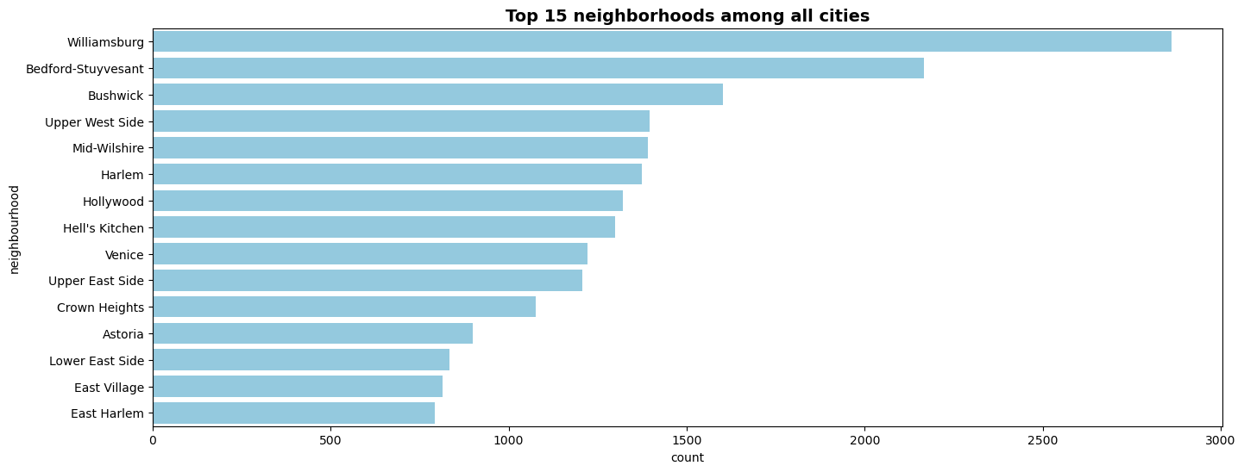
Top Neighborhoods to buy your property

Slide 6
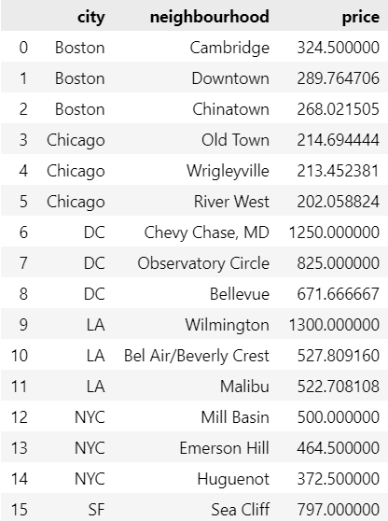
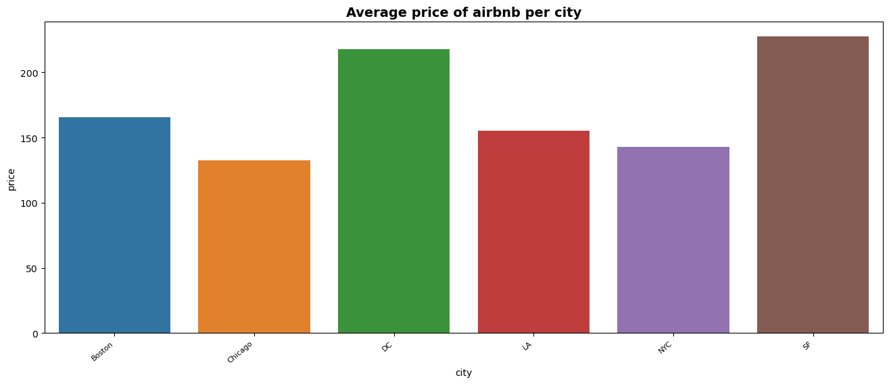
Top Neighborhoods in AVG price

Slide 7
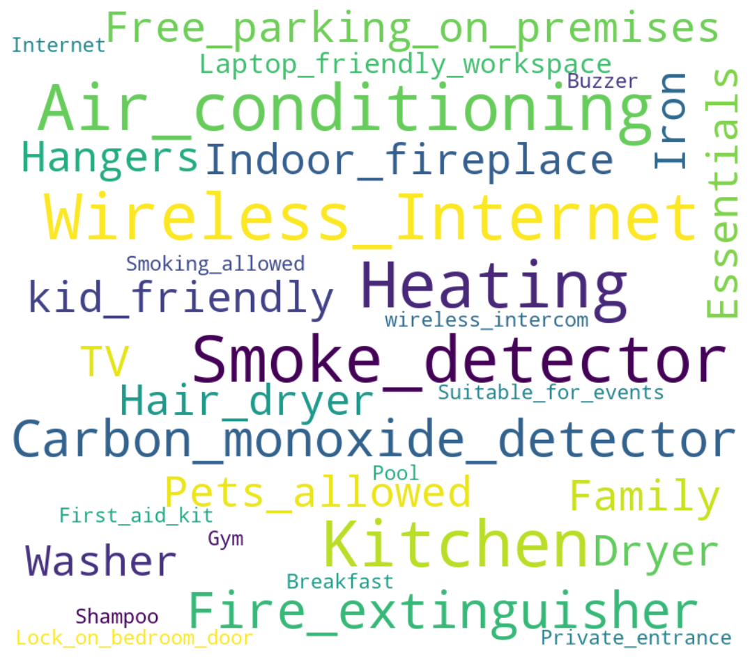
Top amenities in the most expensive Airbnbs
The most common amenities in the expensive Airbnbs are:
Smoke detectors
Carbon Monoxide detectors
Air Conditioning
Heating
Wireless Internet

Slide 8
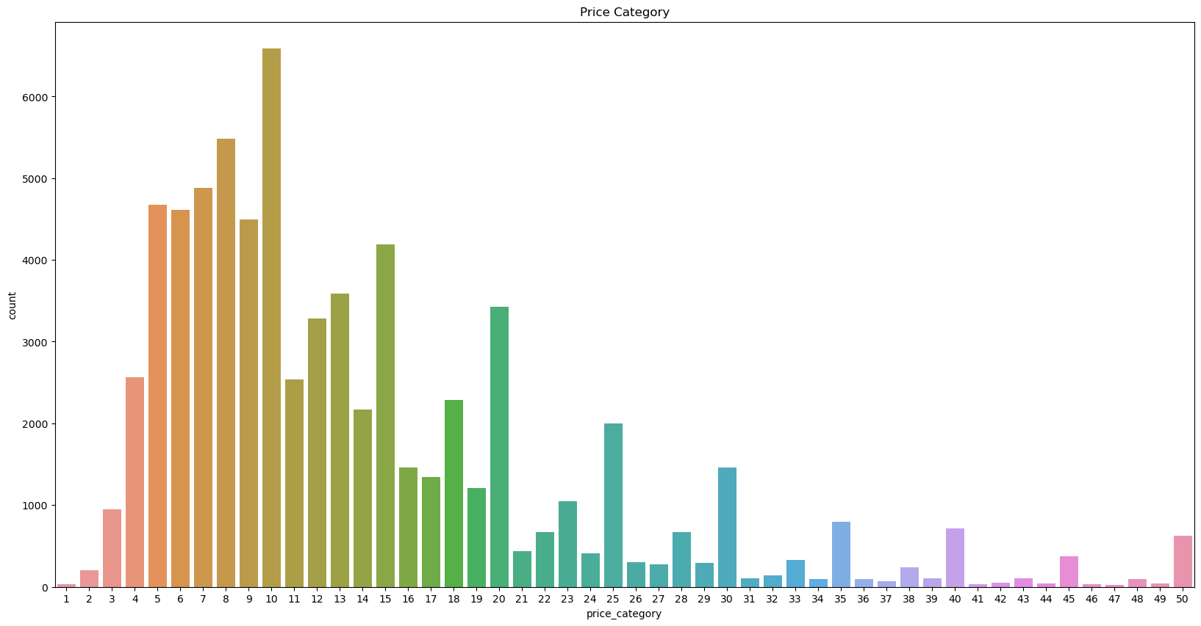
Price Categories Distribution

Slide 9
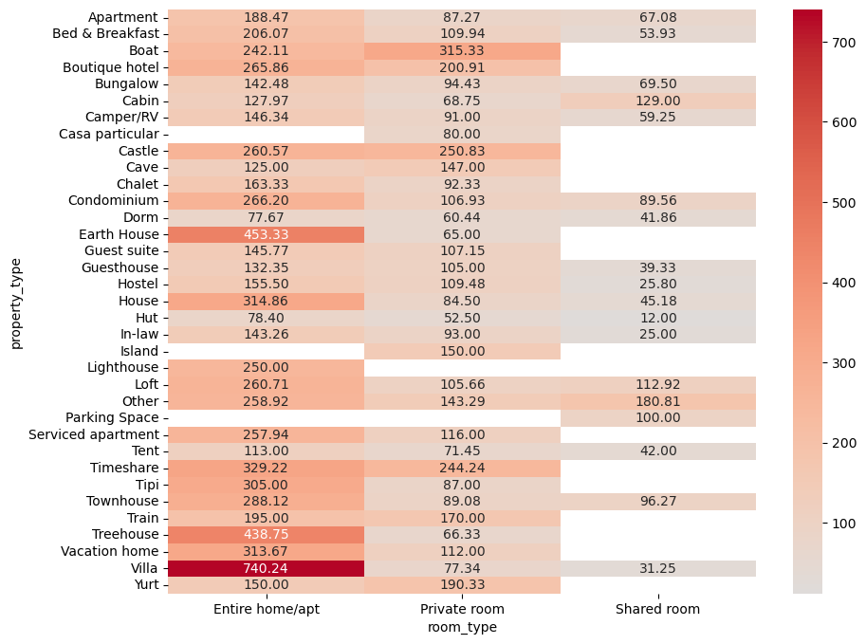
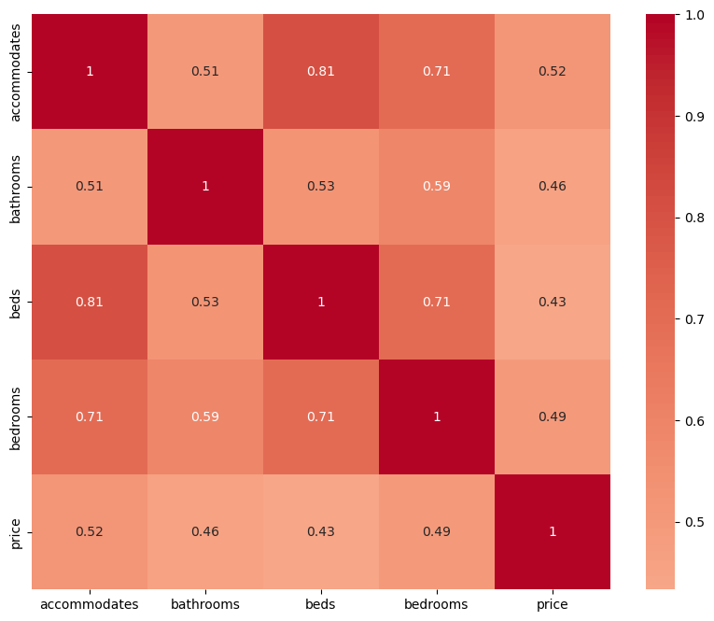
Property, room types insights
Correlations between features

Slide 10
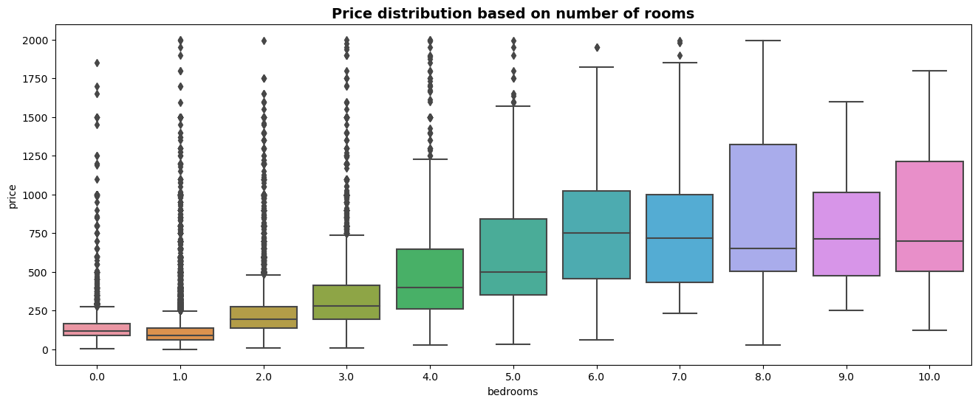
Price Correlated Features

Slide 11
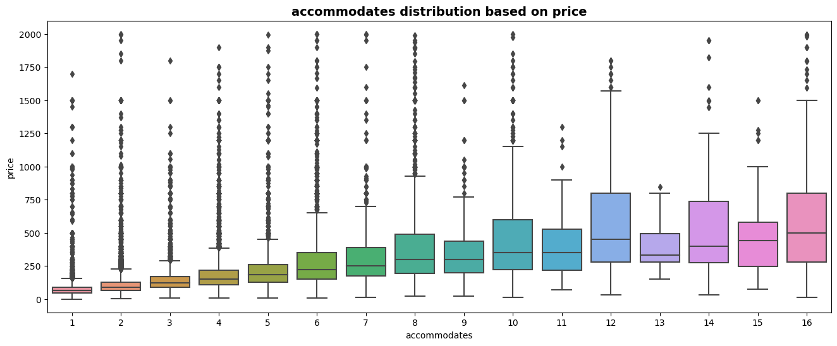
Price Correlated Features

Slide 12
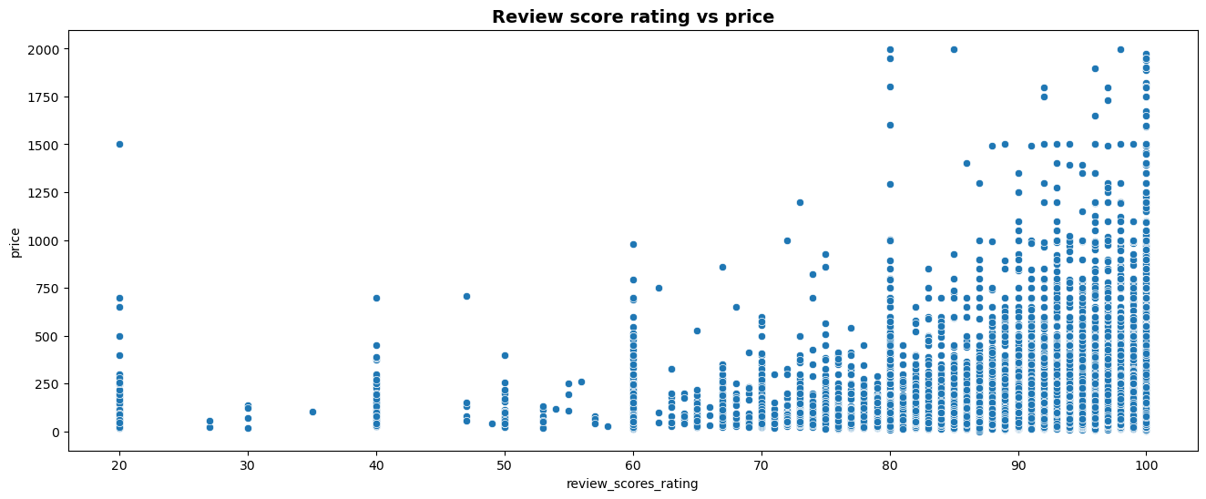
Price Correlated Features

Slide 13
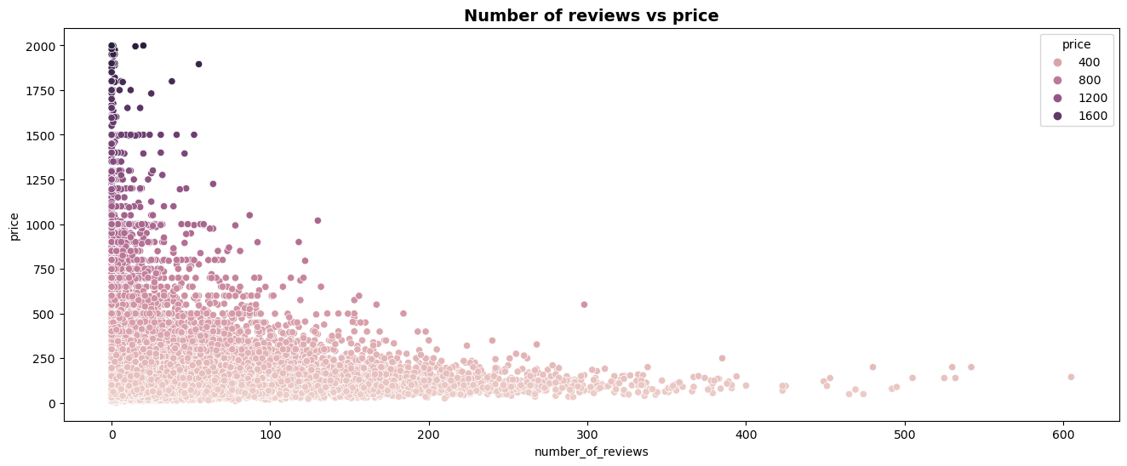
Price Correlated Features

Slide 14
Non-Correlated Data
The Analysis showed that in our data there was:
No correlation between the cancellation policy and city
No correlation between the cancellation policy and the price

Slide 15




Technical Insights
We Developed a couple of models to help business owner decide what prices to give their properties and given some data about the property the model can predict the city where the property is located
SVM model to predict the city
Random Forest Model to predict the price
Polynomial Regression model to predict the price

Slide 16


Price Prediction Model
We used two model to predict the price
We used the following as features
['beds', 'bedrooms', 'city’, 'number_of_reviews’, 'cancellation_policy’, 'review_scores_rating', 'room_type', 'property_type', 'neighbourhood', 'cleaning_fee', 'instant_bookable’, 'accommodates', 'amenities', 'latitude', 'longitude']
71%
67.2%
Random Forest
accuracy
Polynomial Regression
accuracy

Slide 17
City Prediction Model
We used an SVM model to predict the city using the following features
['price','bathrooms', 'cleaning_fee', 'bedrooms', 'number_of_reviews', 'cancellation_policy', 'review_scores_rating', 'latitude', 'longitude']
99.89%
SVM
accuracy

Slide 18

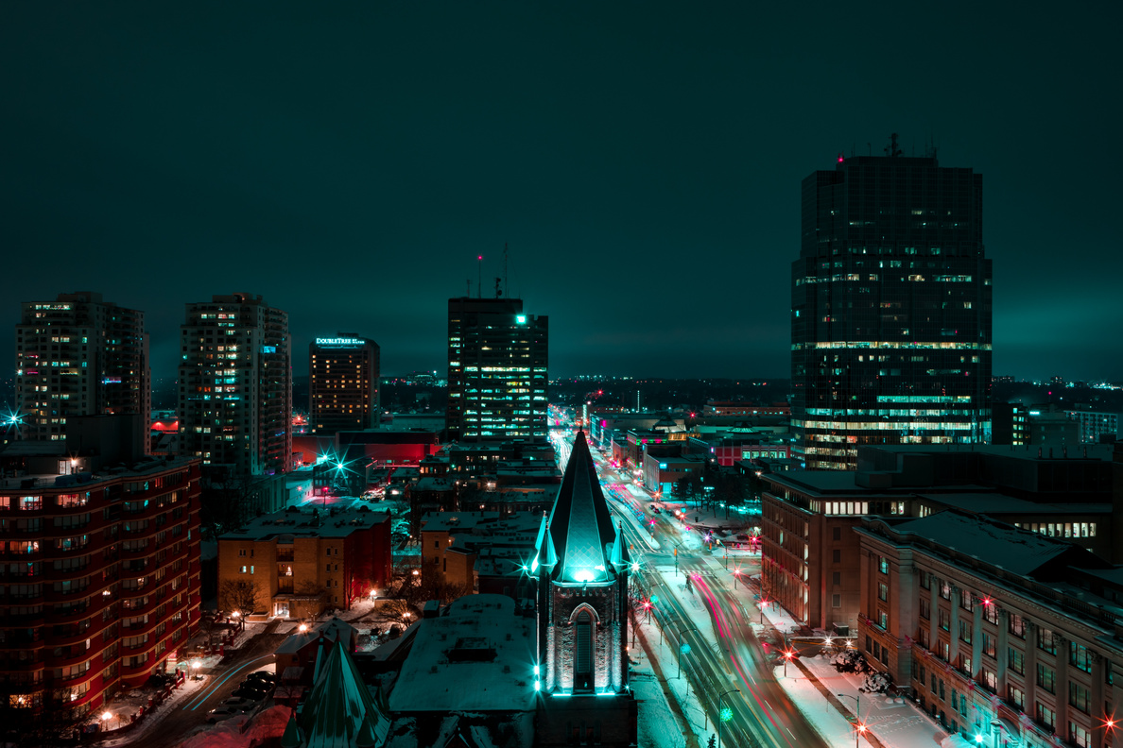

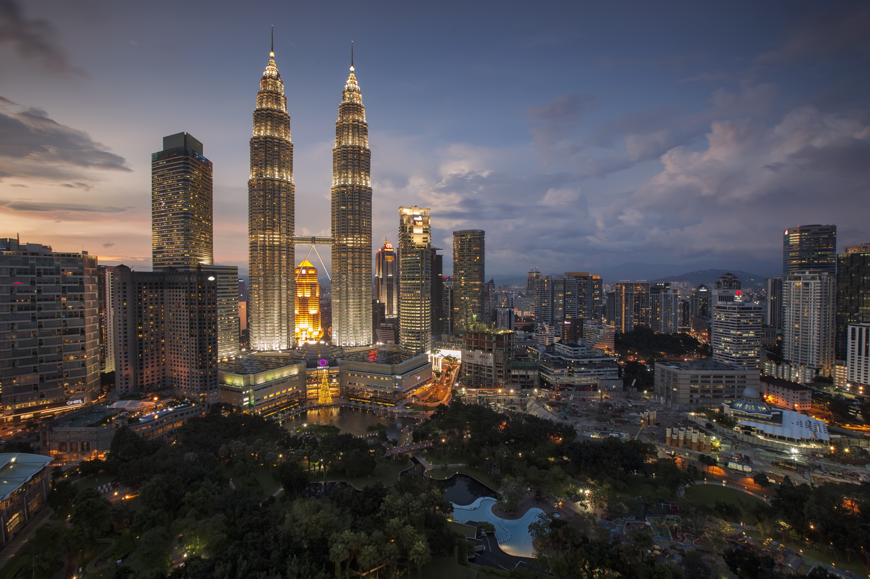



Thank you!!

